Slide 1
JSP-JAVA SERVER PAGES

Slide 2
Syllabus…
Servlets: Introduction
Web application Architecture
Http Protocol & Http Methods
Web Server & Web Container
Servlet Interface
GenericServlet
HttpServlet
Servlet Life Cycle
ServletConfig
ServletContext
Servlet Communication
Session Tracking Mechanisms

Slide 3
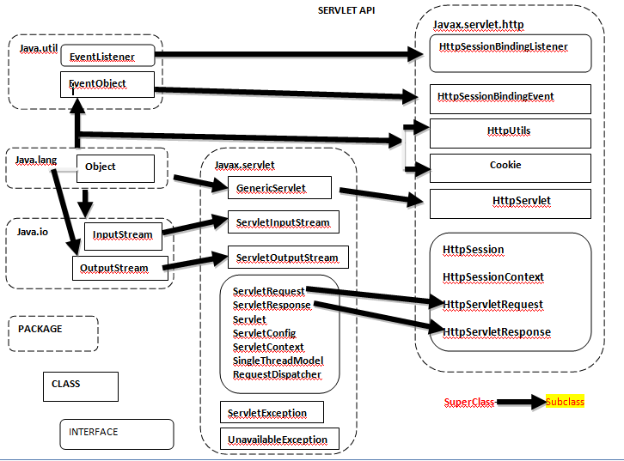

Slide 4
jsp
JSP: Introduction
JSP LifeCycle
JSP Implicit Objects & Scopes
JSP Directives
JSP Scripting Elements
JSP Actions: Standard actions and customized actions

Slide 5
JSP Overview - History
Earlier dynamic web pages were developed with CGI
  Web Applications eventually outgrew CGI because of the following:
    Datasets became large
    Increased traffic on sites
    Trouble maintaining state and session information
    Performance bottlenecks
    Can involve proprietary APIs

Slide 6
JSP Overview - Software
With a foundation in Java, JSP
  Threads incoming requests
  Supports the definition of tags that abstract functionality within a page in a library
  Interacts with a wide array of databases
  Serves dynamic content in a persistent and efficient manner
    Initially the server automatically separates HTML and JSP code, compiles the JSP code, and starts the servlet, from then on the servlets are stored in the web server’s memory in Java byte code
  Extends the same portability, large class library, object-oriented code methodology, and robust security measures that have made Java a top choice
  Does not require a Java programmer

Slide 7
JSP
JSP is another technology for developing web applications.
It is a template for web page that uses java code to generate an HTML document dynamically
It is not meant to replace servlet.
JSP is an extension of servlet technology, & it is common practice to use both in same web applications.
JSP run in server-side component known as a JSP container which translates them into equivalent Servlet
JSP uses the same techniques as those found in servlet programming.

Slide 8
Java Server Pages(JSP)
JSP pages typically comprise of:
Static HTML/XML components.
Special JSP tags
Optionally, snippets of code written in the Java programming language called "scriptlets."

Slide 9
JSP Advantages
Separation of static from dynamic content.
Write Once Run Anywhere
Dynamic content can be served in a variety of formats.
Recommended Web access layer for n-tier architecture.
Completely leverages the Servlet API.
JSP uses simplified scripting language based syntax for embedding HTML into JSP.
• JSP containers provide easy way for accessing standard objects and actions.
• JSP reaps all the benefits provided by JAVA servlets and web container environment, but they have an added advantage of being simpler and more natural program for web enabling enterprise developer
• JSP use HTTP as default request /response communication paradigm and thus make JSP ideal as Web Enabling Technology.

Slide 10
Why Use JSP
JSP is built on top of servlets, so it has all the advantages of servlets
JSP is compiled into its corresponding servlet when it is requested at the first time
The servlet stays in memory, speeding response times
Extensive use of Java API (Applications Programming Interface) for networking, database access, distributed objects, and others like it
Powerful, reusable and portable to other operating systems and Web servers
servlets is a programmatic technology requiring significant
developer expertise,
JSP can be used not only by developers, but also by page designers
JSP is the inherent separation of presentation from content
facilitated

Slide 11
Relationships
In servlets,
  HTML code is printed from java code
In JSP pages
  Java code is embadded in HTML code
Template text
Java
HTML
Java
HTML

Slide 12
JSP
They are automatically recompiled when necessary
They exist in web server document space, no special URL mapping is required to address them
They are like HTML pages ,they have compatibility with web development tools

Slide 13
How it works
Request for JSP , container determines name of class
If it does not exist or older one then it creates Java Source Code
Compiles it , loads its instance if not loaded
If JSP file is modified then container retranslates and recompiles it

Slide 14
JSP
Source
page
1. request
2.
WEB
BROWSER
Generated
Servlet Source
Code
3.
Compiled
Servlet Class
4. response
THE STEPS FOR JSP REQUEST

Slide 15
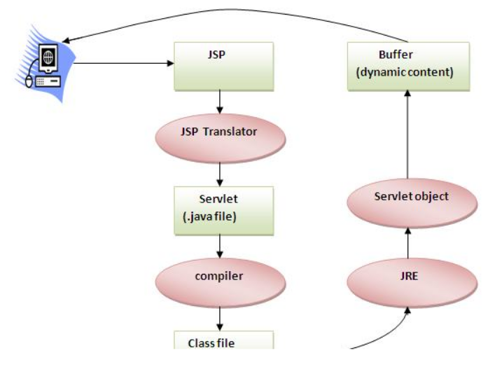

Slide 16
start
Determine class name
No
Yes
Does class already exist
Class newer than JSP?
Translate JSP source into java servlet source
Yes
No
Compile servlet source code into class file
Instance already running?
No
Load class & create instance
Send request to this instance

Slide 17
An Example
<HTML>
<HEAD>
<TITLE>Hello World Example</TITLE>
</HEAD>
<BODY>
<H2>Hello World Example</H2>
<B><% out.println("Hello World"); %></B>
</BODY>
</HTML>

Slide 18
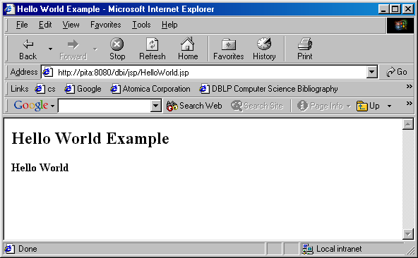

Slide 19
JSP Architecture
The JSP page implementation class file extends HttpJspBase,
which in turn implements the Servlet interface.
the service method of this class, _jspService(), essentially inlines the contents of the JSP page.
Although _jspService() cannot be overridden,
the developer can describe initialization and
destroy events by providing implementations for the jspInit() and jspDestroy() methods within their JSP pages.

Slide 20
Once this class file is loaded within the servlet container,
the _jspService() method is responsible for replying to a client's request.
By default, the _jspService() method is dispatched on a separate thread
by the servlet container in processing concurrent client requests,

Slide 21
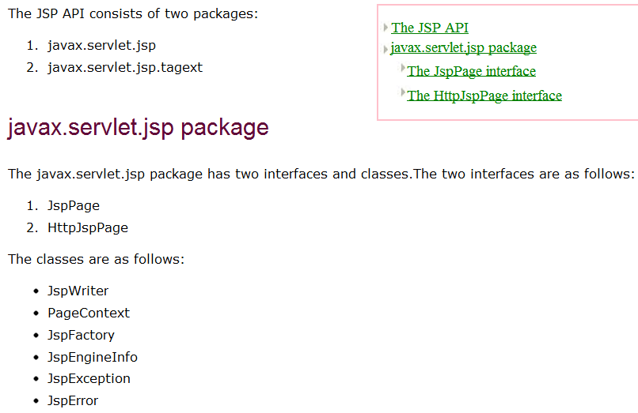
JSP -API

Slide 22
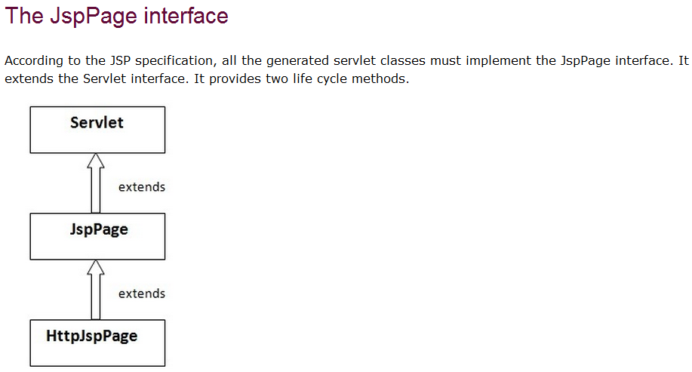

Slide 23
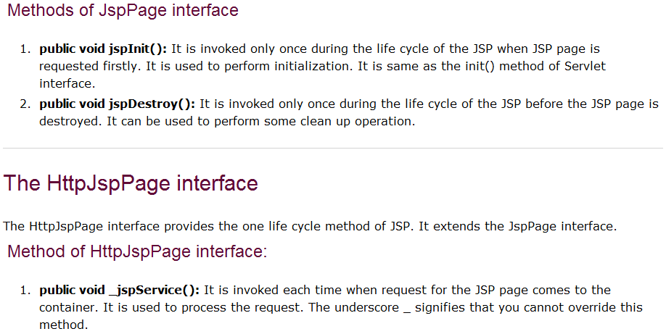

Slide 24
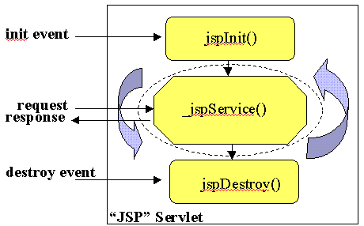

Slide 25
Component of JSP
JSP file can contain JSP elements, fixed template data or both .
The elements which are called jsp tags make up the syntax & semantics of jsp.
Template data includes parts that the jsp container does not understand such as html tags.

Slide 26
Introduction – JSP v/s Servlet
How is JSP different / similar to Servlet?
Servlets | JSP
Handles dynamic data
Handles business logic | Handles presentation logic
Lifecylce methods init() : can be overridden service() : can be overridden destroy() : can be overridden | Lifecylce methods jspInit() : can be overridden _jspService() : cannot be overridden jspDestroy() : can be overridden
Html within java out.println(“<htrml><body>”); out.println(“Time is” + new Date()); out.println(“</body></html>”); | Java within html <html><body> Time is <%=new Date()%> </body></html>
Runs within a Web Container

Slide 27
Introduction – Comments
JSP Comments
  <%-- {CODE HERE} --%>
  Does not show the comments on the page
  Does not show the comments in page source
  Can only be used outside JSP Elements
HTML Comments
  <!– {CODE HERE} -->
  Does not show the comments on the page
  Shows the comments in page source
  Can only be used outside JSP Elements
Single line Comments
  // {CODE HERE}
  When put outside JSP Elements, shows comments on the page & source
  When put inside Scriptlets/Declarations, does not show on page &
  source
  Can be used inside scriptlets/declarations and outside JSP Elements

Slide 28
JSP Elements – Intro
Need to write some Java in your HTML?
Want to make your HTML more dynamic?
JSP Declarations :: Code that goes outside the service method
JSP Scriptlets :: Code that goes within the service method
JSP Expressions :: Code inside expressions is evaluated
JSP Directives :: Commands given to the JSP engine

Slide 29
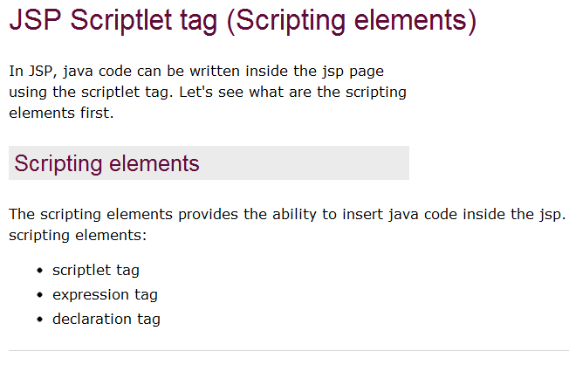

Slide 30
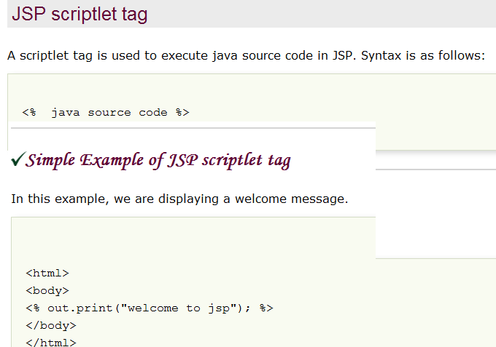

Slide 31
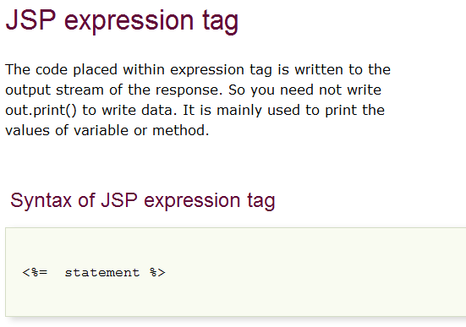

Slide 32
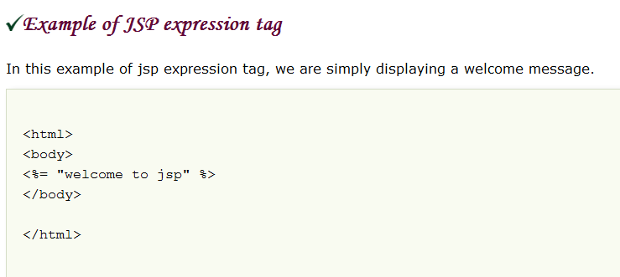

Slide 33
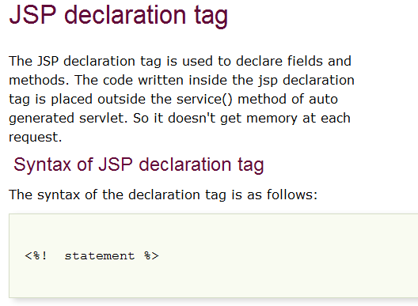

Slide 34
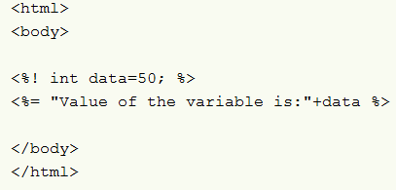
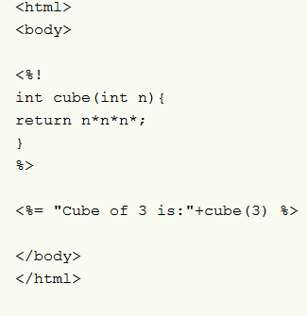

Slide 35
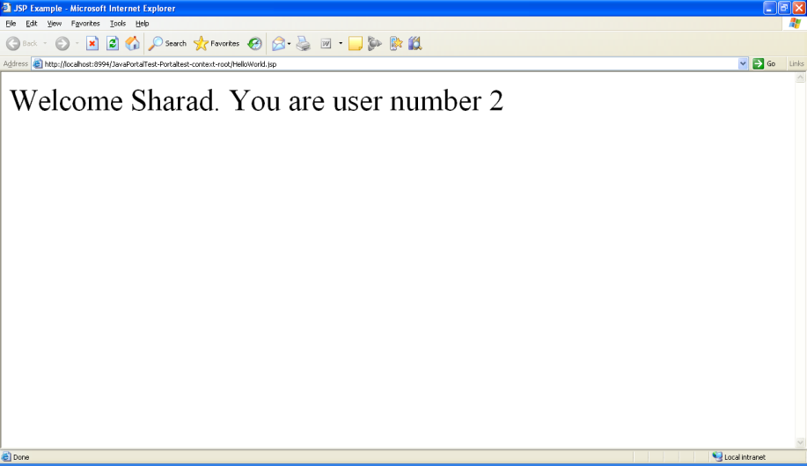
JSP Elements - Example
  <html><head><title>JSP Elements Example</title>
  </head>
  <body>
  <%! int userCnt = 0; %>
  <%
  String name = "Sharad";
  userCnt++;
  %>
  <table>
  <tr><td>
  Welcome <%=name%>. You are user number <%=userCnt%>
  </td></tr>
  </table>
  </body>
  </html>
Declarations
Scriptlets
Expressions

Slide 36
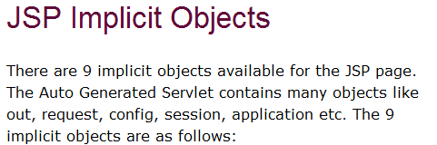
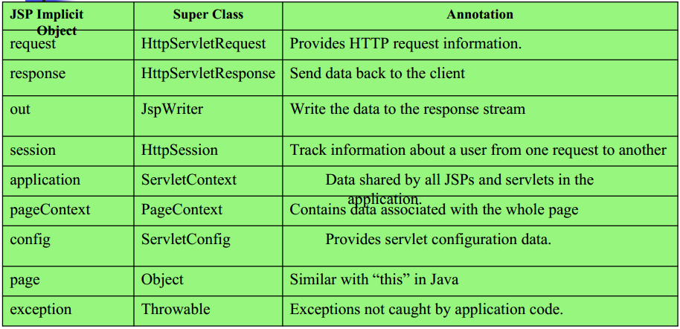

Slide 37
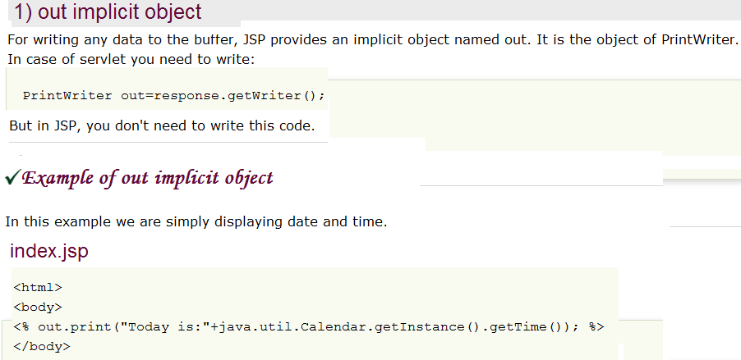

Slide 38
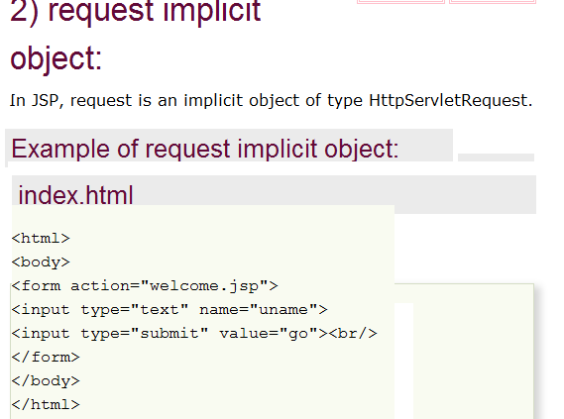

Slide 39
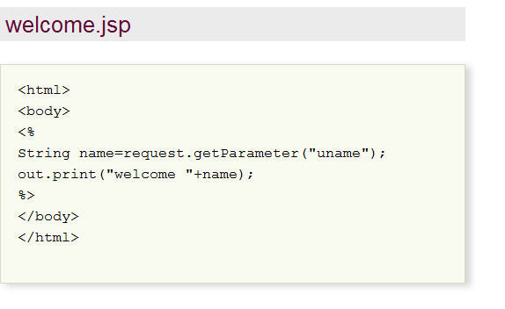

Slide 40
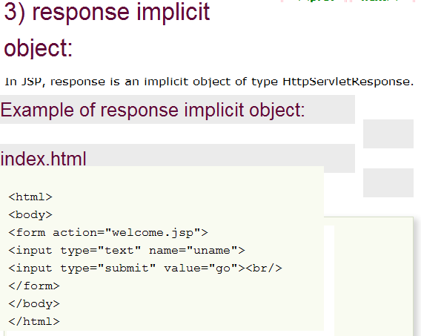

Slide 41
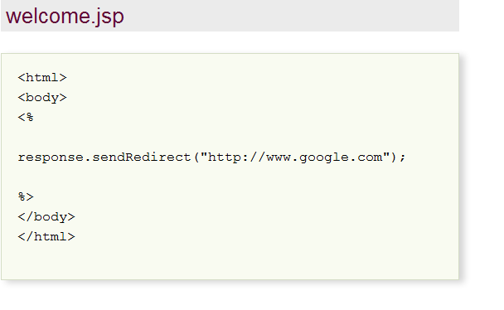

Slide 42
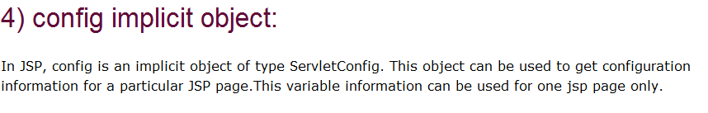
Remaining implicit objects

Slide 43
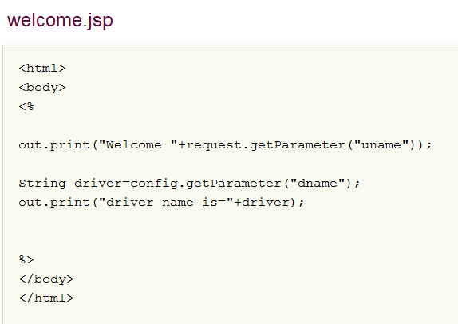

Slide 44
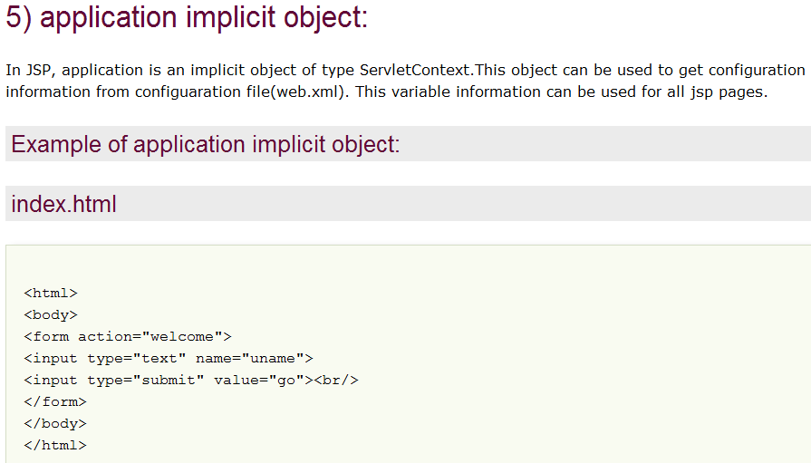

Slide 45
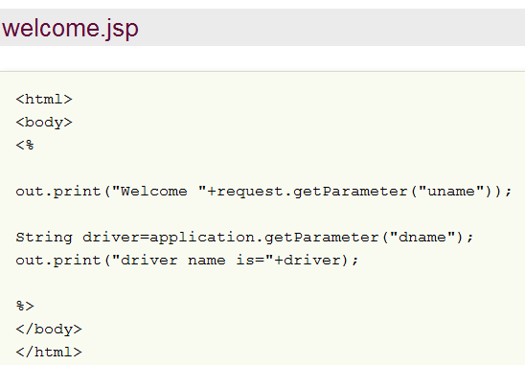

Slide 46
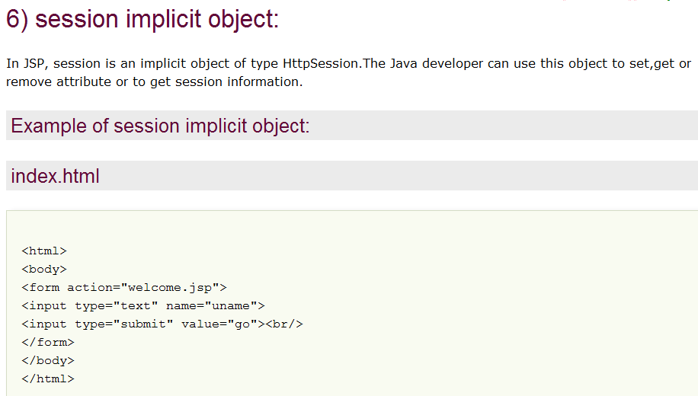

Slide 47
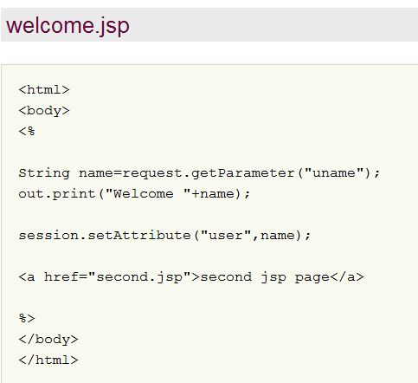

Slide 48
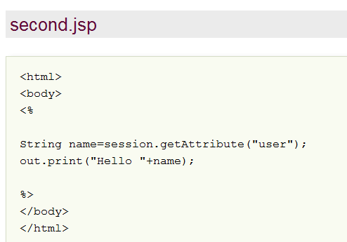

Slide 49
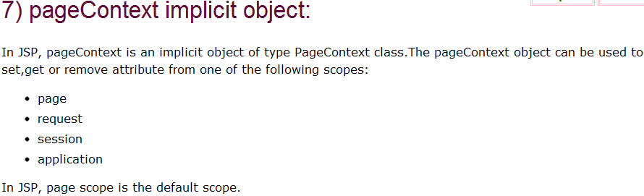

Slide 50
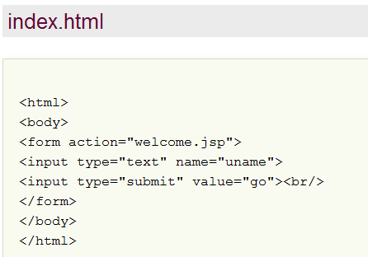

Slide 51
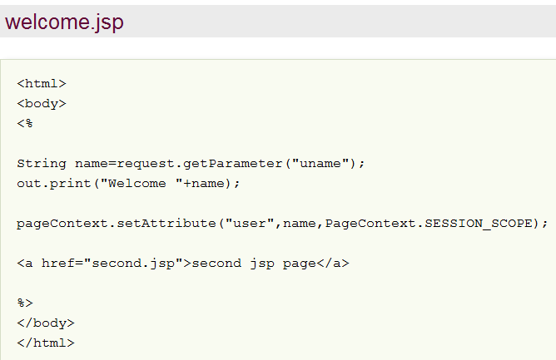

Slide 52
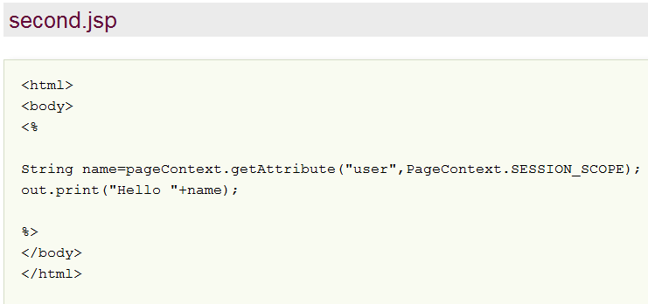

Slide 53
